Slide 1
Trees
Non-Linear Data structure which represents parent-child relationship

Slide 2
Definitions
A tree is a non-linear data structure which represents hierarchical relationship between data items stored.
Node: a data element
Root node:has no parent
Branch: link between two nodes
Sibilings: Nodes of same parent
Eg: B,C (parent A)
Leaf nodes: nodes with no children
Eg: D,E,F,G
Subtree: subset of a tree which itself is a tree
Degree of a node: no. of subtree of a node
Eg: Degree of A-2, Degree of B-2, Degree of F-0
Level /Depth 0node
A
root/ancestor node
Height 2de
Level/Depth 1node
B
C
2
Height 1e
branchode
Level/Depth 2 node
D
E
F
G
Height 0de

Slide 3
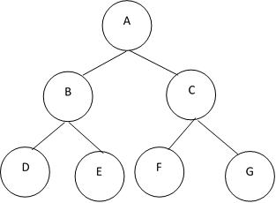
Definitions
Note: Tree is a special type of graph
Depth of a node: For any node n, it is the length of the unique path from root to n. Depth/level of root node is zero
Height of a node: For any node n, it is the length of the longest path from node n to leaf. The height of leaf node is zero.
Binary tree: a tree in which a node has at most two children (no child, one child or two children)

Slide 4
Definitions
Ternary tree: a tree in which a node has at most three children.
General tree/k-ary tree: a tree in which a node has more than three children(n children,n>3).
A
B
C
D
E
F
G
H
A
B
C
D
E
F
G
H
I
J

Slide 5
Definitions
Complete Binary Tree: A complete binary tree of height h has between 2^{h} and 2^{h+1}-1 nodes. In complete binary tree the last level is not filled completely
Full Binary Tree: A full binary tree of height h has 2^{h+1}-1 nodes.
Note: A full binary tree is a complete binary tree, but all complete binary tree is not a full binary tree.

Slide 6
Representation of a Binary Tree
Linear representation (arrays)
For a tree of height h, decide the array size using 2^{h+1}-1 nodes.
If a parent node is at position i then place its left child in 2i+1 position and right child in 2i+2 position.
Linked representation

Slide 7
General Tree to Binary Tree conversion
A
A
B
B
C
D
C
E
G
D
E
F
G
H
I
F
H
I
J
L
M
N
J
M
K
K
N
General tree
L
Binary tree (left-child right-sibiling representation)
The root of the Binary Tree is the Root of the Generic Tree.
The left child of a node in the Generic Tree is the Left child of that node in the Binary Tree.
The right sibling of any node in the Generic Tree is the Right child of that node in the Binary Tree.

Slide 8
Expression tree-binary tree in which leaf nodes are operands and the interior nodes are operators.
Convert the given infix expression into postfix.
Read the postfix expression character by character.
If the character read is an operand create a node and push its pointer to stack
If the character read is an operator, pop top two pointers from the stack and add it as right child and left child of operator respectively and push the pointer of new tree to stack.

Slide 9
Example
Infix: a+b*c-d, postfix: abc*+d-
1. 2. 3.
4.
5. 6.
7.
A
B
C
A
*
B
C
+
D
A
*
-
B
C
+
D
A
*
B
C

Slide 10
Construct an expression tree for the following expressions
a+b+c+d+e
a*(b+c-d*e)/f
a+(b-c)*(d+e)

Slide 11
Binary Tree Traversals
Processing the nodes of a tree by visiting it exactly once.

Slide 12
Binary Tree Traversals
Preorder (root, left, right)
Inorder (left, root, right)
Postorder (left, right, root)
Apart from this we have Level order

Slide 13
Structure of a node
struct tree
{
int data;
struct tree *right,*left;
}*root;

Slide 14
void preorder(node T)
{
if(T!=NULL)
{
printf("%d\t",T->data);
preorder(T->left);
preorder(T->right);
}
}
typedef struct tree *node; //typedef assigns alternative names to existing data types

Slide 15
void inorder(node T)
{
if(T!=NULL)
{
inorder(T->left);
printf("%d\t",T->data);
inorder(T->right);
}
}

Slide 16
void postorder(node T)
{
if(T!=NULL)
{
postorder(T->left);
postorder(T->right);
printf("%d\t",T->data);
}
}

Slide 17
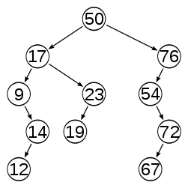
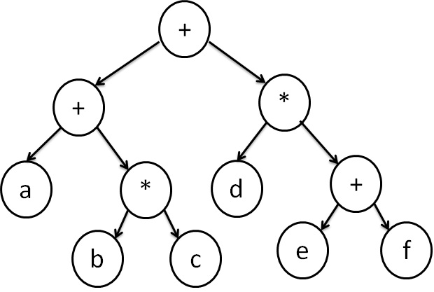
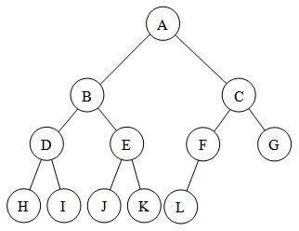
Perform tree traversals on these trees

Slide 18
Binary Search Tree (BST)
A BST is a binary tree in which each parent node is greater than its left child and lesser than its right child.
On considering the root, all elements on left subtree < root and all elements on right subtree > root
Traversing the BST in in-order will get the data elements traversed in sorted order
4
2
6
1
3
5
7

Slide 19
node insert(int x,node T)
{
struct tree *newnode;
newnode=malloc(sizeof(struct tree));
if(T==NULL)
{
newnode->data=x;
newnode->left=NULL;
newnode->right=NULL;
T=newnode;
}
else
{
if(x<T->data)
T->left=insert(x,T->left);
else
T->right=insert(x,T->right);
}
return T;
}

Slide 20
node FindMin(node T)
{
if(T==NULL)
return NULL
else if(T->left==NULL)
return T;
else
return FindMin(T->left);
}

Slide 21
node FindMax(node T)
{
if(T==NULL)
return NULL
else if(T->right==NULL)
return T;
else
return FindMax(T->right);
}

Slide 22
node Find(int x, node T)
{
if(T==NULL)
return NULL
if(x< T->data)
return find(x,T->left);
else if( x > T->data)
return find(x, T->right);
else
return T;
}

Slide 23
node del(int x,node T)
{ node tmpcell;
if(T==NULL)
print("No tree is constructed");
else
if(x<T->data) //traverse left
T->left=del(x,T->left);
else
if(x>T->data)//traverse right
T->right=del(x,T->right);
else // element found for deletion has two children
if(T->left && T->right)
{tmpcell=FindMin(T->right);//replace the deleted element with minimum element in the right subtree
T->data=tmpcell->data;
T->right=del(T->data,T->right); }
else // one or zero children
{tmpcell=T;
if(T->left==NULL)
T=T->right;
else if(T->right==NULL)
T=T->left;
free(tmpcell);}
return T; }

Slide 24
AVL TREES- Adelson Velskii and Landis Trees
Height balanced trees
A BST in which each node has a balanced factor of -1 or 0 or 1
Balanced Factor of a node=Height of left subtree-Height of right subtree.
If a node is imbalanced, rotations are performed
Single rotation
Performed when a node creating imbalance is inserted as a left child in the left subtree or as a right child in the right subtree.
Double rotation
Performed when a node creating imbalance is inserted as a left child in the right subtree or as a right child in the left subtree.

Slide 25
AVL Trees
Construct an AVL Tree on inserting the following elements:
10, 20, 15, 25, 30, 16, 18, 19, Delete 30
H, I, J, B, A, E, C, F, D, G, K, L

